Slide 1
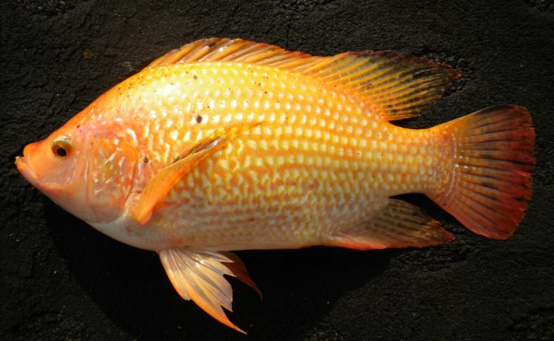
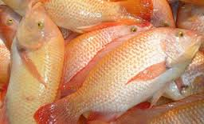
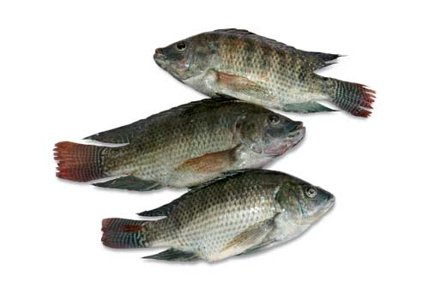
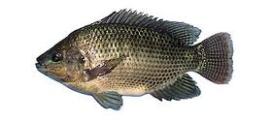
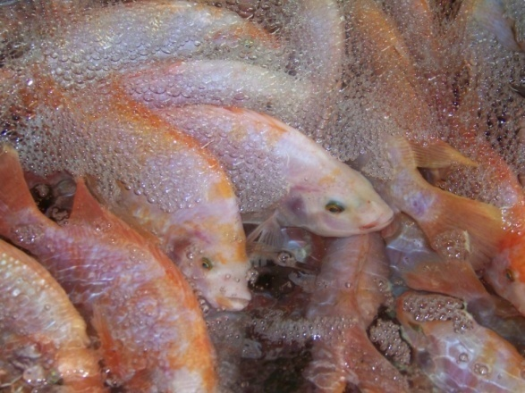
Saline Tilapia (Oreochromis sp) Broodstock Production : Growth and Reproductive Performance as effort the seed supply for culture
MOHAMAD SOLEH , AGUSTIN, KHAEMUDIN
Main Center for Brackishwater Aquaculture (MCBA)
(JEPARA-INDONESIA-2016

Slide 2
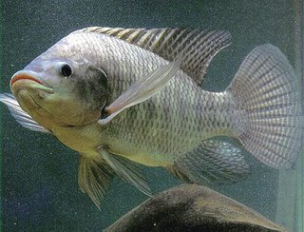
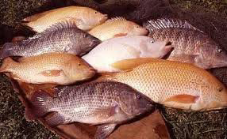
INTRODUCTION
Reasons
THE TILAPIAS :
1. Human global consume
2. Biofilter and commercial culture in pond
3. Potential development in sea water : floating net culture, live bait for pole and line fishing
4. High demand of saline offspring/seed for culture
5. Offspring must prepared from saline/salt tilapia breeder in order to appear the gen of high salinity tolerant

Slide 3
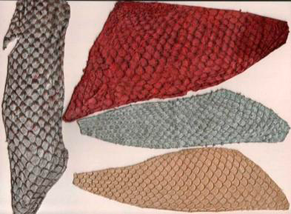
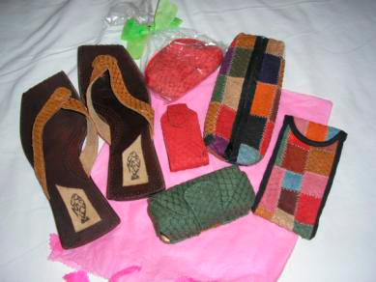
1. The consumers of tilapias have been globally (as : meat fillet : nice taste/delicious/unsoft, souvenir of it leather etc.)
shoes, belt
Fillet
slipper, wallet

Slide 4
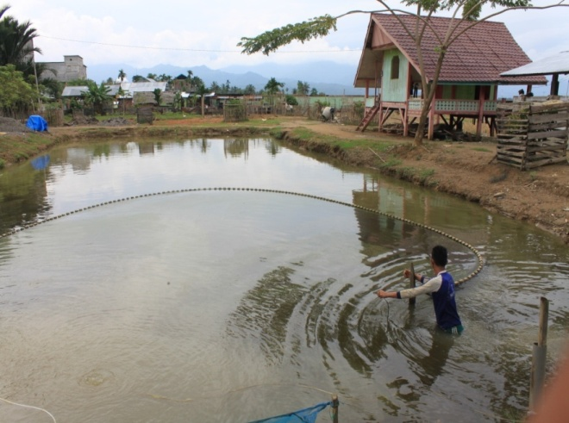
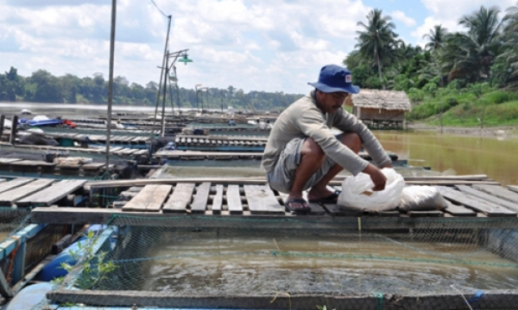
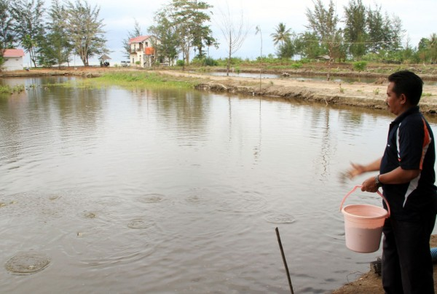
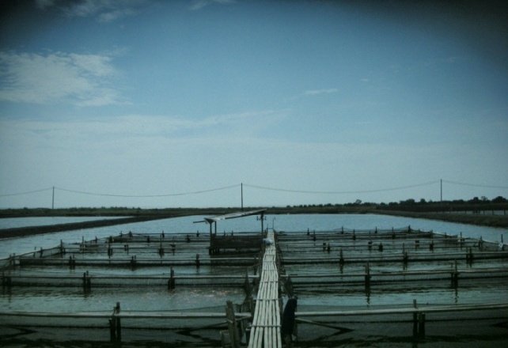
2. Contributes as biofilter in shrimp culture to minimize the disease problems, but today become main species for commercial culture
TRADITIONAL CULTURE IN LAND
TRADITIONAL CULTURE IN CAGE
COSTAL CULTURE
Mono culture, the water ca be continually exchange shrimp pond
The same pond with shrimp
POLYCULTURE IN BRACKISH or SEA WATER POND (modern)
MONOCULTURE IN BRACKISH or SEA WATER POND (modern)

Slide 5
OBJECTIVE and TARGET
OBJECTIVE :
to produce saline tilapia breeder which have high salinity tolerant (> 30 g.L−1) by stress high salinity and have good performance during rearing in salt/sea water
TARGET :
the breeder : optimum growth and spawn in water salinity of 10-15 g.L−1

Slide 6
MATERIALS & EQUIPMENTS
- freshwater seed tilapia
- length 3-5 cm/pcs
- local strain of genetic improvement : GESIT/Sultana, Larasati, Kunti, Srikandi
- artificial feed (commercial pellet, protein content > 25 %)
- papaya extract (enzym)
- concrete tank for rearing (water volume : 4 m³), fibreglass/plastic box for high salinity stress (water volume : 100 l)
- refractosalinometer, dissolve oxygen meter
- timer/watch
- field equipment

Slide 7
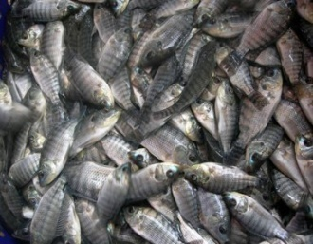
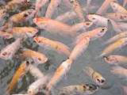
METHODE of SALINITY STRESS
Freshwater offspring of genetic improvement
adaptation (3-7 days)
Direct stress to high salinity (35 g.L−1)
stop
SR 50% pop. or 2 hours
stock density 1 pcs/l
Stock in salinity 20 g.L−1, 24 hours
Move to salinity > 30 g.L−1
Rearing the fingerling & broodstock in the sea water
Spawning the breeder (10-20 g.L−1)
Rearing offspring in the sea water

Slide 8
Methods of REARING THE BREEDER
Rearing in the tank , volume : 4 m3
Modular system, stocking density 250 – 300 pcs (weight 20 g/pcs); 200 – 250 pcs (weight 50 g/pcs); 150 – 200 pcs (weight 100 g/pcs); 100 – 150 pcs (weight 200 g/pcs)
Commercial artificial feed (pellet, protein 25 %, 10-3 % biomass, freq. 3 times/day)
Food enrichment by papaya extract : 50 ml/kg of feed, daily
Siphoning debris (feces, uneating food etc.)
Water salinity rearing : 30 g.L−1 (sea water)
Water exchange > 50 %/day and circulated all day

Slide 9
SPAWNING SYSTEM
Tank preparation and water spawning (salinity 10-15 g.L−1)
Selection : sex (male-female), body weight each strains (GESIT/Sultana, Srikandi, Kunti, Larasati)
Sex ratio 1 : 3 (male-female), stocking density 1 kg/m3 water
Water exchange 50 % volume , a weekly
Feeding : 1-2 % biomass/day, protein > 25 %, frequency 3 times a day
Physically water quality control (temperature, dissolve oxygen) 2 times a week
Eggs harvested last 30 days rearing or the larvae appear swim on water surface

Slide 10
Concrete tanks : facility for saline tilapias rearing (since fingerling to broodstock spawn)

Slide 11
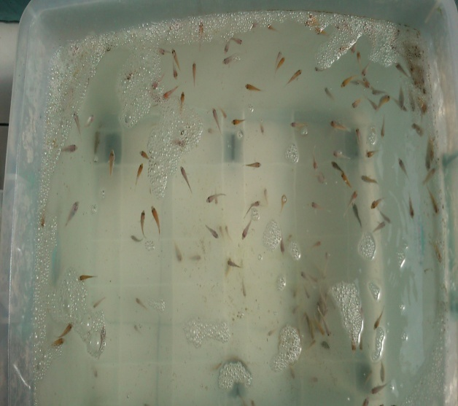
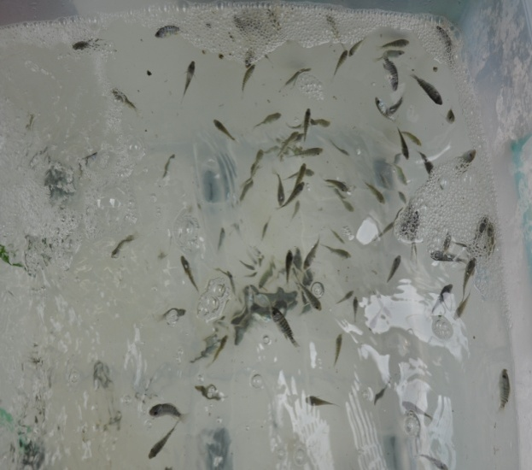
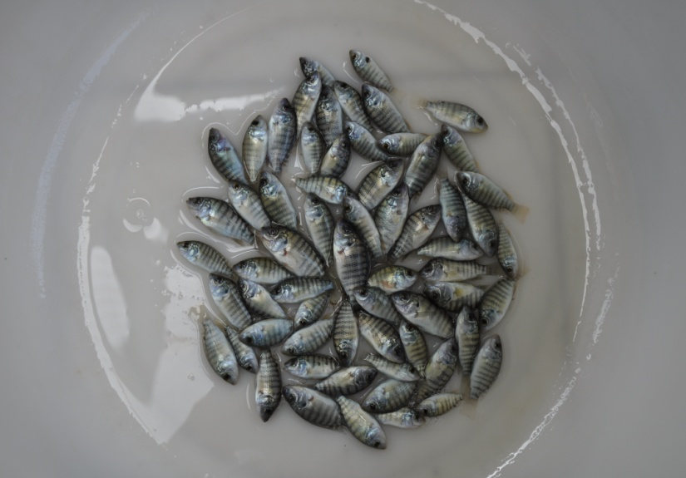
Result stressing in high salinity (35 g.L−1)
Moribund fish
Dead fish
RED TILAPIA
BLACK TILAPIA

Slide 12
Role defense of fry to stress treatment of high salinity (35 g.L−1)
15’ = fish live in bottom
30’ = water begin foam, fluid
excretion, fish still in
base
45’ = fish begin swimming
in midle water
60’ = still swimming in midle
water, apart swim in
surface
75’ = same condition at 60’
90’ = color of body line clear,
fish swimming oblique
105’= more fish swimming on
surface water
120’= more the fish swim
on surface, bright color
150’= fish begin to dye, in
the bottom tank , more
in surface water
180’= dead fish increases in
the bottom
survival rate
time

Slide 13
Growth Performance of Gesit/Sultana strain (each 30 days)
Sampling (S) | Ʃ fish (pcs) | SR (%) | Biomass (kg) | Length average (cm) | Weight average (kg) | Feeding daily (kg/%) | Total feed (kg)
Stock | 189 | 100.0 | 0.474 | 5.41±0.30 | 0.002 | 0.071 (15 %) | 2.134
S1 | 182 | 96.30 | 2.306 | 8.11±0.37 | 0.012 | 0.230 (10 %) | 7.425
S2 | 150 | 78.46 | 9.150 | 14.50±0.52 | 0.062 | 0.640 (7 %) | 19.215
S3 | 132 | 69.39 | 14.410 | 17.75±0.60 | 0.109 | 0.576 (4 %) | 17.292
S4 | 116 | 61.10 | 18.807 | 18.27±0.56 | 0.152 | - | -
 |  | 61.10 | 18.807 | 18.27±0.56 | 0.152 |  | 46.066
ADG |  |  |  |  | Ave: 2.079
FCR |  |  | 1:2.454

Slide 14
Growth Performance of Larasati strain (each 30 days)
Sampling (S) | Ʃ fish (pcs) | SR (%) | Biomass (kg) | Length average (cm) | Weight average (kg) | Feeding daily (kg/%) | Total feed (kg)
Stock | 200 | 100.0 | 0.62 | 4.75±0.31 | 0.003 | 0.093 (15 %) | 2.812
S1 | 198 | 98.40 | 2.30 | 8.93±0.40 | 0.008 | 0.230 (10 %) | 6.927
S2 | 184 | 87.70 | 3.55 | 11.59±0.54 | 0.022 | 0.248 (7 % ) | 7.455
S3 | 164 | 76.57 | 7.74 | 13.30±0.36 | 0.055 | 0.541 (7 % ) | 16.254
S4 | 143 | 66.64 | 9.19 | 16.58±0.70 | 0.074 | 0.643 (7 %) | 19.299
S5 | 123 | 61.50 | 12.22 | 17.13±0.65 | 0.111 | 0.488 (4 %) | 14.664
S6 | 112 | 50.23 | 13.75 | 18.02±0.90 | 0.144 | - | -
Total |  | 50.23 | 13.75 | 18.02±0.90 | 0.144 |  | 67.411
ADG |  |  |  |  | Ave : 0.686
FCR |  |  | 1:4.757

Slide 15
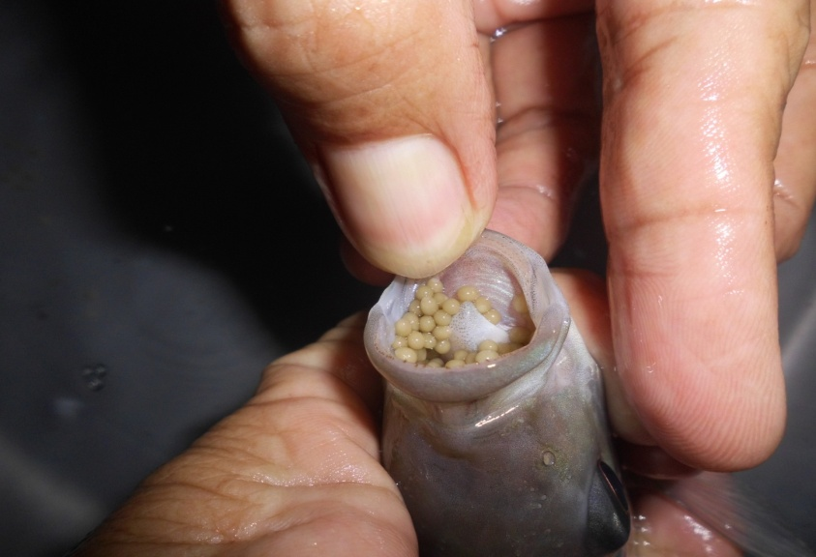
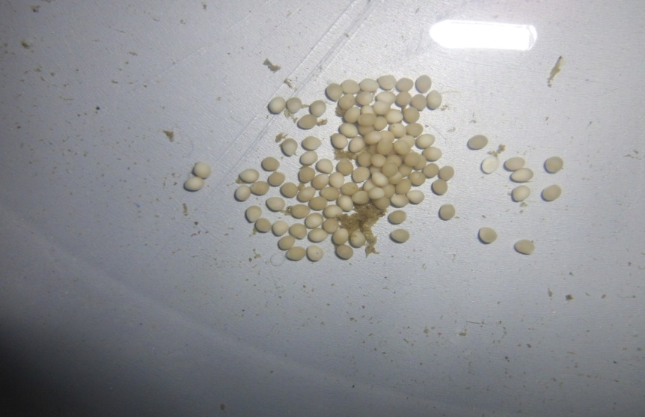
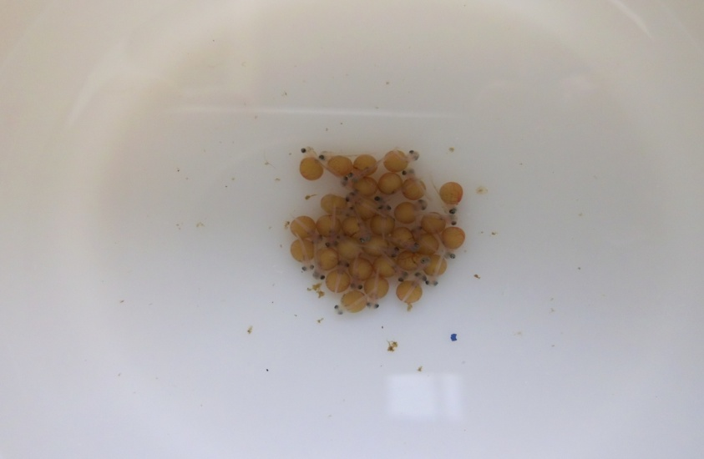
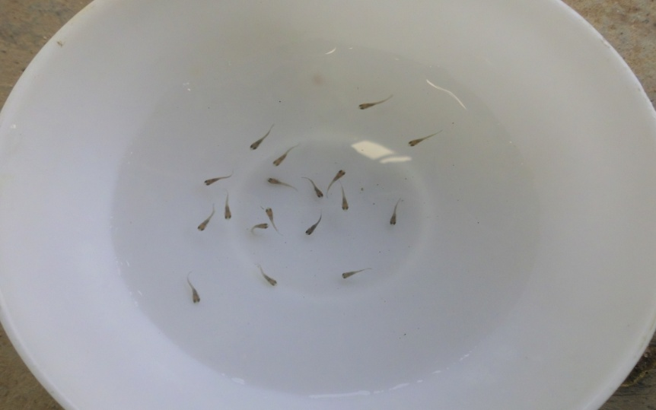
REPRODUCTIVE PERFORMANCE Eggs or larvae harvesting
Eggs or Larvae with yolk in the mouth
Eggs
Larvae with yolk
Larvae

Slide 16
GESIT/Sultana breeder : stressed high salinity, spawned in brackishwater (salinity 10-15 g.L−1)
Length (cm) | Weight (g) | Ʃ Eggs (pcs) | Ʃ/g body weight | Ʃ Larvae (pcs) | Ʃ/g body weight
21.0 | 160 | - | - | 800 (swim) | 5.00
21.3 | 165 |  |  | 820 (swim) | 4.96
20.0 | 130 | - | - | 700 (swim) | 5.38
22.5 | 225 | - | - | 1,317 (eggs yolk) | 5.85
18.5 | 110 | - | - | 574 (eggs yolk) | 5.21
18.2 | 105 | - | - | 367 (eggs yolk) | 3.49
21.7 | 230 | - | - | 768 (eggs yolk) | 3.33
21.5 | 200 | - | - | 820 (eggs yolk) | 4.10
22.0 | 235 | - | - | 1,050 (swim) | 4.47
20.5 | 220 | - | - | 1,000 (swim) | 4.54
20.7 | 210 | - | - | 1,100 (swim) | 5.23
19.5 | 125 | - | - | 417 (swim) | 3.25
19.0 | 120 | - | - | 408 (swim) | 3.40
13 samples |  |  |  |  | Ave.= 4.47 (3.25-5.85)

Slide 17
GESIT/Sultana breeder : stressed high salinity, spawned in freshwater (0 g.L−1)………..
Length (cm) | Weight (g) | Ʃ eggs (pcs) | Ʃ Egg/g body weight | Ʃ Larvae (pcs) | Ʃ/g body weight
21.0 | 200 | - | - | 475 (swim) | 2.37
21.0 | 200 | - | - | 559 (swim) | 2.79
20.0 | 175 | 350 | 2.00 | - | -
21.0 | 200 | - | - | 552 (eggs yolk) | 2.76
22.0 | 225 | - | - | 766 (swim) | 3.40
19.2 | 150 | - | - | 669 (swim) | 4.46
20.0 | 150 | - | - | 535 (swim) | 3.56
21.0 | 200 | - | - | 1,040 (swim) | 5.02
21.5 | 200 | 1,168 | 5.84 | - | -
21.5 | 200 | - | - | 500 (eggs yolk) | 2.50
24.0 | 250 | - | - | 1,140 (eggs yolk) | 4.56
23.0 | 200 | - | - | 600 (eggs yolk) | 3.00
22.0 | 150 | 870 | 5.80 | - | -
23.0 | 200 | - | - | 1,000 (swim) | 5.00

Slide 18
GESIT/Sultana breeder : stressed high salinity, spawned in freshwater (0 g.L−1)……….. Continued…
Length (cm) | Weight (g) | Ʃ eggs (pcs) | Ʃ egg/g body weight | Ʃ Larvae (pcs) | Ʃ/g body weight
22.0 | 200 | - | - | 748 (swim) | 3.74
20.5 | 200 | - | - | 740 (eggs yolk) | 3.70
21.2 | 225 | - | - | 886 (swim) | 3.93
20.5 | 150 | - | - | 615 (eggs yolk) | 4.10
26.0 | 300 | 1,423 | 4.74 | - | -
23.5 | 300 | - | - | 1,710 (eggs yolk) | 5.70
26.0 | 300 | - | - | 757 (eggs yolk) | 2.52
24.0 | 250 | - | - | 780 (swim) | 3.12
21.0 | 250 | - | - | 550 (swim) | 2.20
 |  |  |  |  | Ave.= 3.60
23 samples |  |  |  |  | (2.20-5.70)

Slide 19
Performance reproduction of KUNTI breeder stressed in high salinity, spawned in salinity 10-15 g.L−1
Length (cm) | Weight (g) | Ʃ Eggs (pcs) | Ʃ egg/g body weight | Ʃ Larvae (pcs) | Ʃ/g body weight
21.5 | 150 | - | - | 783 (eggs yolk) | 5.22
22.0 | 200 | 742 | 3.71 | - | -
19.0 | 100 | - | - | 224 (swim) | 2.24
20.5 | 180 | - | - | 1,000 (eggs yolk) | 5.55
21.5 | 200 | - | - | 1,100 (swim) | 5.50
21.3 | 200 | - | - | 1,000 (swim) | 5.00
22.7 | 250 | - | - | 1,100 (eggs yolk) | 4.40
21.3 | 225 | - | - | 945 (eggs yolk) | 4.20
21.0 | 200 | - | - | 645 (swim) | 3.22
21.6 | 210 | - | - | 690 (swim) | 3.28
22.5 | 240 | - | - | 862 (swim) | 3.59
22.0 | 300 | - | - | 1,500 (eggs yolk) | 5.00
21.7 | 200 | - | - | 500 (swim) | 2.25
 |  | 742 | 3.71 |  | Ave.= 3.78

Slide 20
KUNTI breeder (spawned in salinity :10-15 g.L−1) …………
Length (cm) | Weight (g) | Ʃ Eggs (pcs) | Ʃ egg/g body weight | Ʃ larvae (pcs) | Ʃ larvae/g body weight
21.0 | 170 | - | - | 950 (swim) | 5.58
22.5 | 200 |  |  | 1,000 (egg yolk) | 5.00
20.0 | 200 | - | - | 1,645 (swim) | 8.22
21.0 | 160 | - | - | 1,050 (swim) | 6.56
19.5 | 140 | - | - | 786 (egg yolk) | 5.61
18.0 | 100 | - | - | 224 (egg yolk) | 2.24
22.5 | 200 | - | - | 1,364 (swim) | 6.82
20.0 | 140 | - | - | 950 (swim) | 6.77
20.5 | 150 | - | - | 530 (swim) | 3.22
21.0 | 162 | - | - | 653 (eggs yolk) | 3.28
23.0 | 235 | - | - | 1,030 (eggs yolk) | 3.59
19.5 | 138 | - | - | 378 (eggs yolk) | 5.00
22.0 | 188 | - | - | 1,100 (eggs yolk) | 2.25
17.8 | 79 |  |  | 227 (swim) | 2.87
 | 2,262 |  |  | Total =11,887 | Ave.=4.28 (2.24-8.22)

Slide 21
Performance reproduction of SRIKANDI breeder stressed in high salinity, spawned in salinity : 10-15 g.L−1
Length (cm) | Weight (g) | Ʃ Eggs (pcs) | Ʃ Egg/g body weight | Ʃ Larvae (pcs) | Ʃ Larvae/g body weight
21.5 | 300 | - | - | 777 (swim) | 2.59
22.0 | 280 | - | - | 727 (egg yolk) | 2.60
22.5 | 325 | - | - | 1,075 (swim) | 3.30
21.8 | 310 | - | - | 812 (swim) | 2.63
22.5 | 300 | - | - | 538 (swim) | 1.79
26.0 | 400 | - | - | 540 (swim) | 1.36
23.0 | 220 | - | - | 1,632 (egg yolk) | 7.41
21.0 | 150 | 1,031 | 6.87 | - | -
24.0 | 250 | - | - | 605 (swim) | 2.42
 | 2,535 |  | 6.78 | 6,706 | Ave.= 3.03
 |  |  |  | total | (1.36-7.41)

Slide 22
CONCLUSION
To produce the broodstock of saline tilapia could be stressed to the seed (3-5 cm) in high salinity (35 g.L−1) and always in the sea water media during reared (salinity 30 g.L−1 or more)
Saline tilapia of Gesit/Sultana strain (black tilapia) performed fast growth, short the time of culture and more high of ADG, FCR and survival rate than Larasati strain (red tilapia)
In this trial females of saline tilapia of Gesit/Sultana breeder was spawned in salinity of 10-15 g.L−1 performed better larvae produces (4.47 pcs/g body weight) than Kunti (4.28 pcs) and Srikandi (3.03 pcs)
Comparative spawned of saline tilapia of Gesit/Sultana breeder in water salinity of 10-15 g.L−1 performed larvae produces 4.47 pcs/g body weight is more better than in freshwater (3.60 pcs/g body weight)

Slide 23
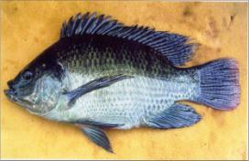
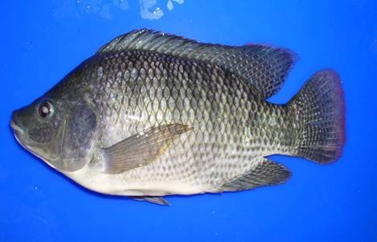
THANK YOU

